Slide 1
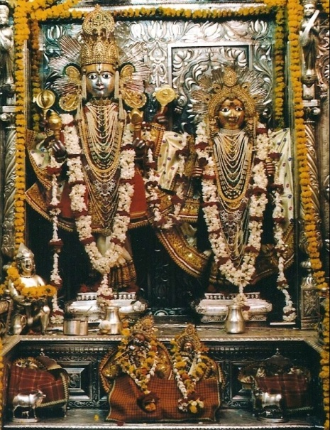

Presentation to Investors
November’2024

Slide 2
JK Organisation

Slide 3


JK Organisation – Vision and Values
Vision
- Dynamic & Successful Business Organisation
A Socially-Valued Enterprise
Business Integrity
Core Values
- Caring for People
- Integrity including Intellectual
Honesty, Openness, Fairness & Trust
- Commitment to Excellence

Slide 4
JK Organisation

Slide 5
JK Organisation – Eastern Zone

Slide 6







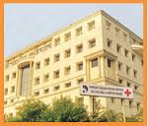
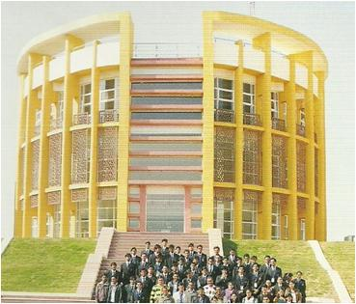


Prominent Businesses of JK Eastern Zone Group
Paper
Cement
Tyre
V-Belts- Oil Seals & Power Transmission Systems
Agri Genetics
USD 4 Billion
30 manufacturing plants
Present in over 100 countries
More than 40,000 employment
Dairy Products
Hospital & Health services
Clinical Research
Education
Defence Electronics
Revenue is for FY 2023-24

Slide 7
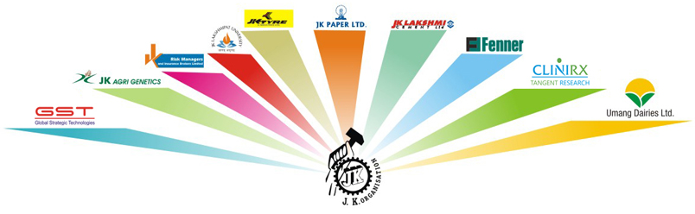
JK Organisation - Eastern Zone Companies.

Slide 9
Index
CONTENTS
PAGE NO.
1
J K Lakshmi Cement (JKLC) Overview
9 – 12
2
Macro Indicators
13- 14
3
Indian Cement Sector
15 - 24
4
JKLC - ESG Initiatives
25 - 28
5
JKLC- Operational and Financial Performance- Q2FY25
29 - 63
6
JKLC- CSR
64 - 69
7
Way Forward
70 - 72

Slide 10
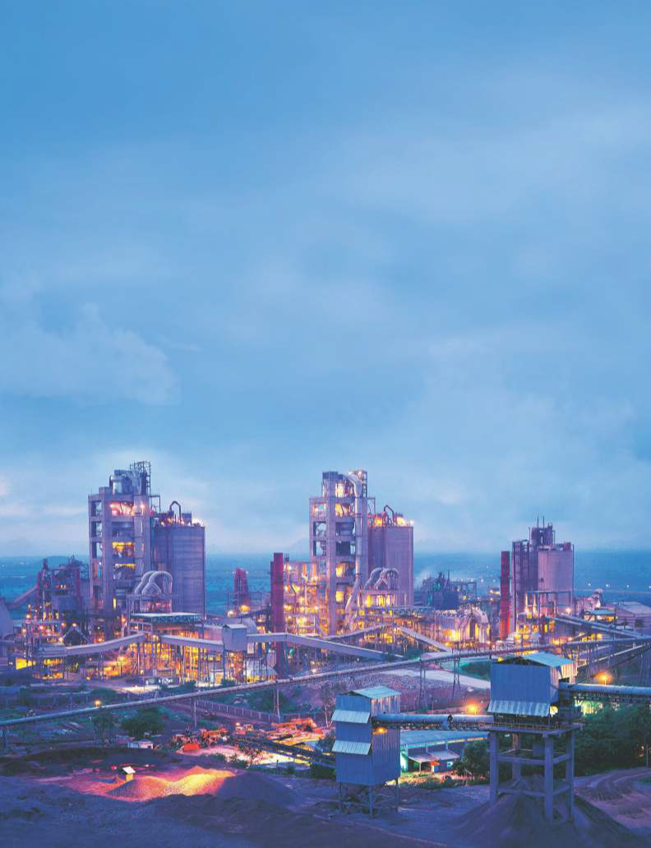
JK Lakshmi Cement
Overview

Slide 11


JKLC & UCWL Plants –Cement/Clinker – Mn MT
1.30
4.70 (3.00)
Jharli
(Grinding Unit
& AAC Block)
4.75 (5.00)
UCWL
Jaykaypuram
Kalol
(Grinding Unit)
0.90
Surat
(Grinding Unit)
Durg
1.35
2.70 (2.00)
Odisha
(Grinding Unit)
0.80

Slide 12
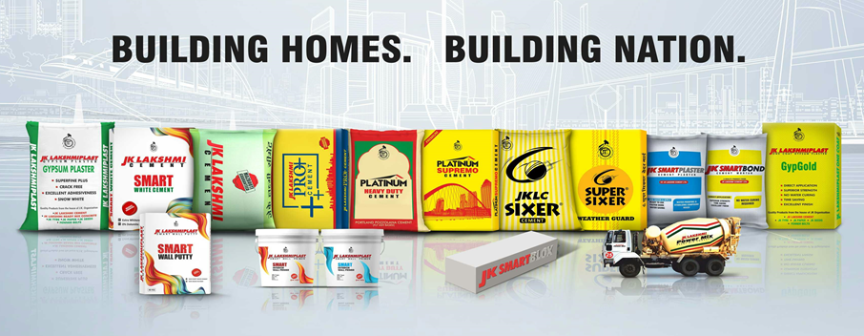







J K Lakshmi Cement & Udaipur Cement Works - Product Portfolio
Notes:
Table to be recd

Slide 13
Journey So Far & Expansion Plans JKLC & UCWL (Subsidiary)
Timelines to reach 30 Million Tonnes by 2030
Capacity in Million MTPA

Slide 14

Macro-Indicators

Slide 15
Macro Indicators - Indian Economy
GDP %tage
(Real GDP, annual percent change) CY | 2023 | 2024 | 2025
World Output | 3.2 | 3.2 | 3.2
Advanced Economies | 1.6 | 1.7 | 1.8
United States | 2.5 | 2.7 | 1.9
Euro Area | 0.4 | 0.8 | 1.5
Germany | -0.3 | 0.2 | 1.3
France | 0.9 | 0.7 | 1.4
Italy | 0.9 | 0.7 | 0.7
Spain | 2.5 | 1.9 | 2.1
Japan | 1.9 | 0.9 | 1.0
United Kingdom | 0.1 | 0.5 | 1.5
Canada | 1.1 | 1.2 | 2.3
Other Advanced Economies | 1.8 | 2.0 | 2.4
Emerging Market and Developing Economies | 4.3 | 4.2
Emerging and Developing Asia | 5.6 | 5.2 | 4.9
China | 5.2 | 4.6 | 4.1
India | 7.8 | 6.8 | 6.5
Emerging and Developing Europe | 3.2 | 3.1 | 2.8
Russia | 3.6 | 3.2 | 1.8
Latin America and the Caribbean | 2.3 | 2.0 | 2.5
Brazil | 2.9 | 2.2 | 2.1
Mexico | 3.2 | 2.4 | 1.4
Middle East and Central Asia | 2.0 | 2.8 | 4.2
Saudi Arabia | -0.8 | 2.6 | 6.0
Sub-Saharan Africa | 3.4 | 3.8 | 4.0
Nigeria | 2.9 | 3.3 | 3.0
South Africa | 0.6 | 0.9 | 1.2
Emerging Market and Middle-income Economies | 4.4 | 4.1 | 4.1
Low Income Developing Countries | 4.0 | 4.7 | 5.2
Est.
Indian Economy – Not with standing global headwinds, among
The fastest growing economy in the world
1
Despite a broader slowdown, the Indian economy is expected to continue to grow above 6% level and remain among the fastest growing economies of the world
2
Government’s increasing capital spending, particularly on infrastructure, to boost growth and competitiveness.
3
Robust growth in the infrastructure segment and revival of real estate.
4
Fiscal deficit falling from 9.2 percent in FY21 to 5.6 percent in FY24
5
Public debt has fallen from over 87 percent of GDP in F20/21 to around 83 percent in FY23
6
The persisting headwinds – rising borrowing costs, tightening financial conditions and ongoing inflationary pressures – are expected to weigh on India’s growth
Source: IMF, World Economic Outlook Update, September 2023

Slide 16
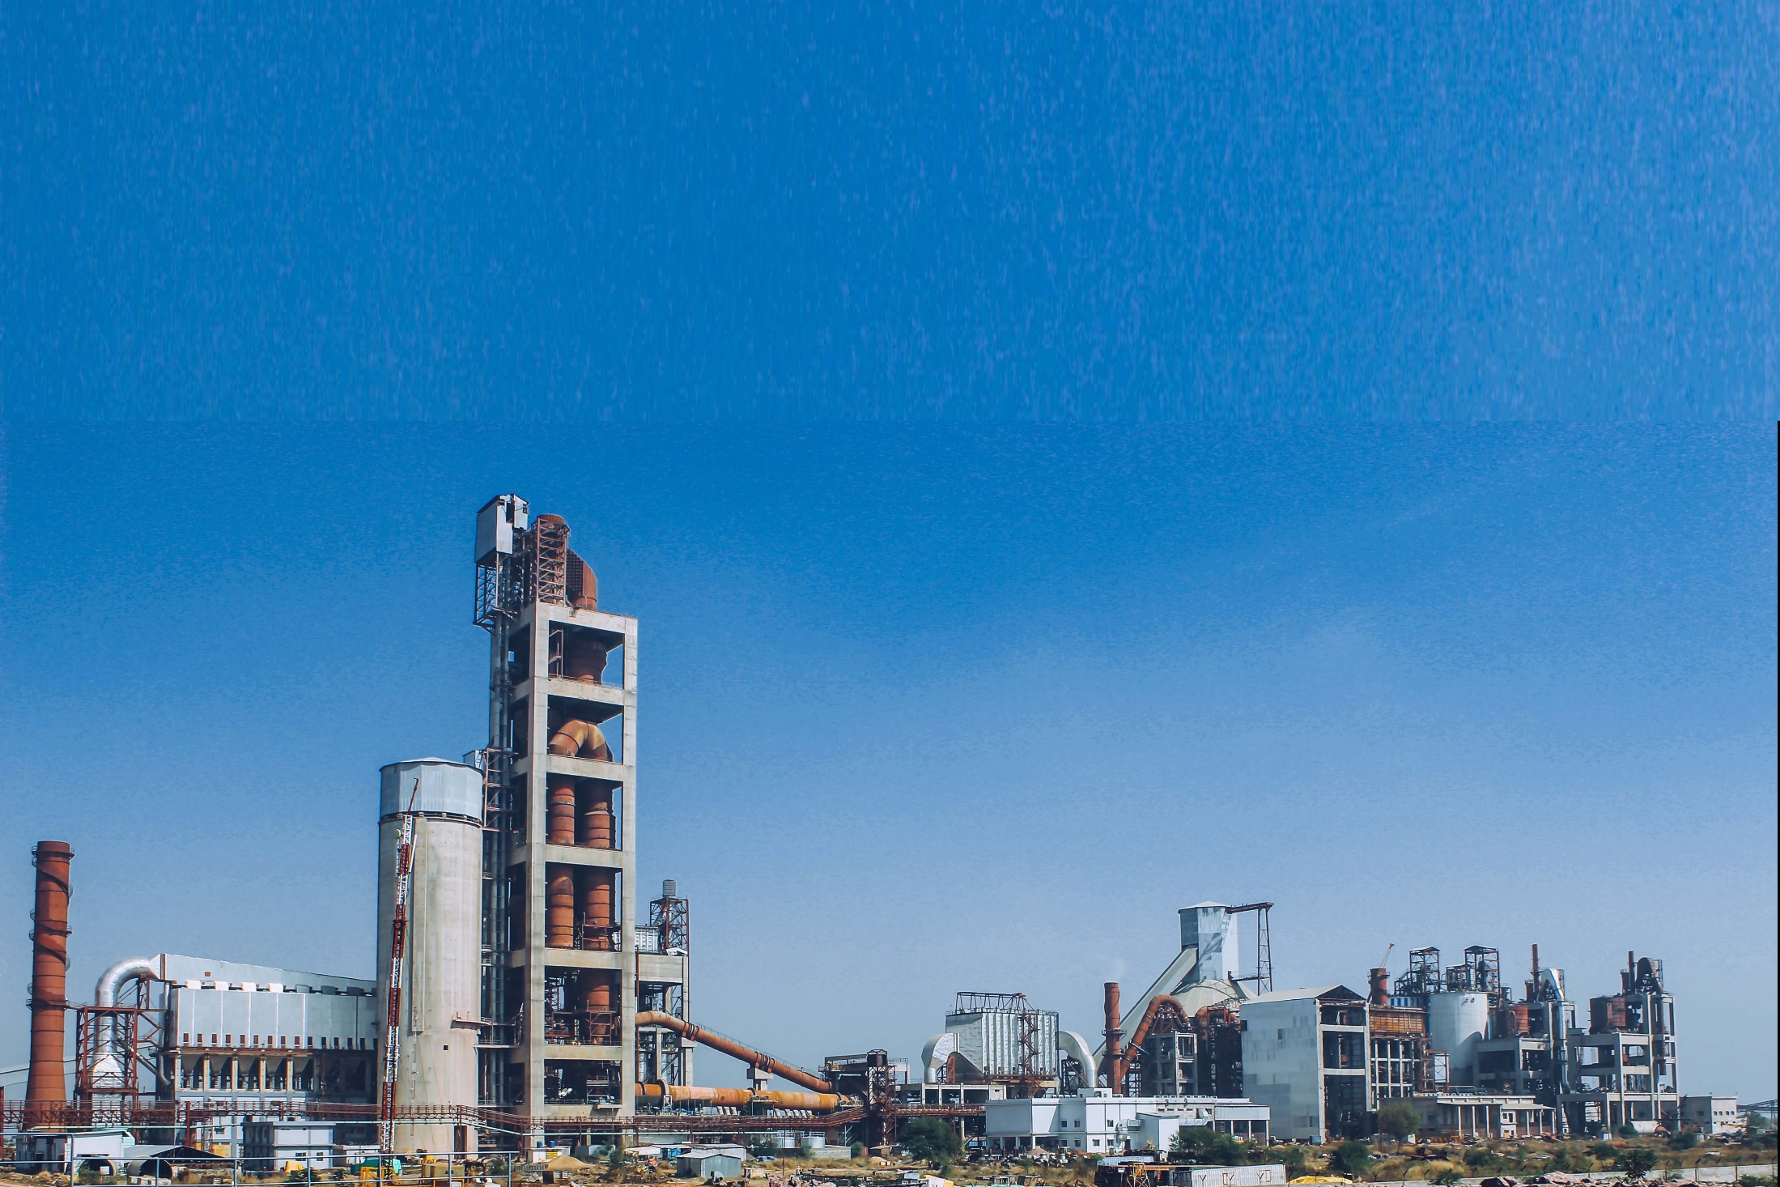
Indian Cement Sector

Slide 17
Indian Cement Industry- Under penetrated market
2,000
Per-capita cement consumption (kg)
1,500
1,000
World average
500-550 kg
500
0
1650-1700
(China)
1000-1100
(Korea)
850-900
(Vietnam)
720-770
(Egypt)
460-510
(Turkey)
380-430
(Japan)
360-410
(Russia)
300-320
(USA)
280-300
(Indonesia)
280-300
(Brazil)
250-270
(India)
Data Source – Research reports

Slide 18
Infra and Housing to spur demand in FY2024-2030 followed by Industrial & Commercial Segments
Commercial and Industrial demand likely to pick-up amid capex push by large players, PLI scheme, overall economic recovery.
Expected to grow ~ 6%
Nuclear families : Key driver to urban housing requirement.
Focus on urban low-cost housing in coming years.
Expected to grow ~ 7%
High focus on bullet trains, expressways, rail networks and metro projects. Expected to grow ~ 8%
Rural low-cost housing nears completion.
Likely to grow at a marginally slower rate in the medium term.
Growth projections at ~5%
*Based on analyst reports, industry estimates

Slide 19
Cost Trend of Imported Coal, Crude Oil and Pet Coke

Slide 20
Cost Trend of Imported Coal, Crude Oil and Pet Coke

Slide 21
Cement Demand Supply Capability & Gap (All India)
Qty. Mn.Tons
Sl. No.​ | Particulars​ | Actual​ |  | Projections​
​ |  | FY 23​ | FY 24​ | FY 25​ | FY 26​ | FY 27​
1​ | Installed Capacity​ | 594​ | 631​ | 684​ | 739 | 785
2​ | Additions During the Year​ | 32​ | 43​ | 62 | 49 | 43​
3​ | Demand Growth %​ | 9%​ | 9%​ | 7%​ | 8%​ | 8%​
4​ | Domestic Demand​ | 393 | 427​ | 455​ | 491 | 530​
5​ | Exports​ | 6​ | 6​ | 7​ | 7​ | 8​
6​ | Total Dispatch​ | 399​ | 433​ | 462​ | 498 | 538
7​ | Surplus Capacity on Installed Capacity​ | 195 | 198​ | 222 | 241​ | 247​
8​ | Capacity Utilisation (CU) %​ | 67%​ | 69%​ | 68%​ | 67%​ | 69%​
9​ | Surplus Capacity (%) on Installed Capacity​ | 33%​ | 31%​ | 32%​ | 33%​ | 31%​
*Based on sectoral reports, industry estimates
Notes:
Remove this slide/decide later

Slide 22
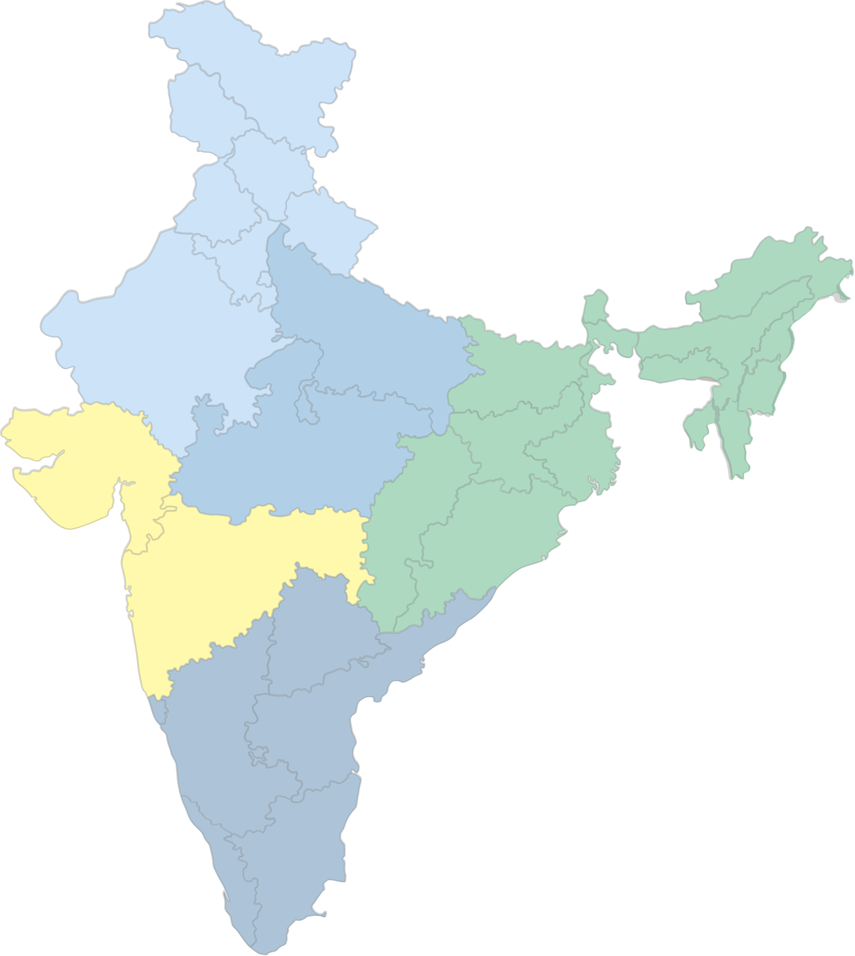
All India trends in Demand Growth & Capacity Additions
2022
2024
2027
Capacity
CAGR - 5.7%
Capacity
CAGR – 7.5%
Capacity
Demand
Surplus
Capacity
Demand
Surplus
Capacity
Demand
Surplus
565
360
35%
631
433
31%
785
538
31%
Capacity Share of Top 4 ~50% in FY24
and~54% in Q1FY25
Demand
CAGR – 8.9%
Demand
CAGR – 7.5%

Slide 23
Cement Demand Supply Gap (North Zone)^
Qty. Mn.Tons
Sl. No.​ | Particulars​ | Actual​ |  | Projections​
​ |  | 2022 - 23​ | 2023-24​ | 2024 - 25​ | 2025 - 26​ | 2026 - 27​
1​ | Installed Capacity​ | 118​ | 127​ | 135​ | 139​ | 147​
2​ | Capacity Additions during the yr.​ | 3​ | 15​ | 2​ | 6​ | 10​
3​ | Cement Production​ | 86​ | 92​ | 97​ | 102​ | 110​
4​ | Demand Growth %​ | 7%​ | 5%​ | 4%​ | 7%​ | 8%​
5​ | Domestic Demand​ | 72​ | 76​ | 79​ | 84​ | 91​
6​ | Net Imports from Other Zones​ | 14​ | 16​ | 18​ | 18​ | 19​
7​ | Capacity Utilisation​ | 73%​ | 73%​ | 72%​ | 73%​ | 75%​
8​ | Surplus Capacity​ | 27%​ | 27%​ | 28%​ | 27%​ | 25%​
*North Zone- J&K, Punjab, Haryana, Himachal, Delhi, Uttarakhand and Rajasthan
*Based on sectoral reports, industry estimates
Notes:
Remove this slide/decide later

Slide 24
Cement Demand Supply Gap (West Zone)^
Qty. Mn.Tons
Sl. No.​ | Particulars​ | Actual​ |  | Projections​
​ |  | 2022 - 23​ | 2023-24​ | 2024 - 25​ | 2025 - 26​ | 2026 - 27​
1​ | Installed Capacity​ | 89​ | 92​ | 102​ | 117​ | 124​
2​ | Capacity Additions during the yr.​ | 4​ | 2​ | 18​ | 12​ | 2​
3​ | Cement Production​ | 51​ | 53​ | 58​ | 66​ | 72​
4​ | Demand Growth %​ | 9​ | 9​ | 6​ | 8​ | 8​
5​ | Domestic Demand​ | 71​ | 77​ | 82​ | 89​ | 96​
6​ | Net Imports from Other Zones​ | 20​ | 24​ | 24​ | 22​ | 24​
7​ | Capacity Utilisation​ | 57%​ | 57%​ | 57%​ | 56%​ | 58%​
8​ | Surplus Capacity​ | 43%​ | 43%​ | 43%​ | 44%​ | 42%​
*West Zone- Gujarat & Maharashtra
*Based on sectoral reports, industry estimates
Notes:
Remove this slide/decide later

Slide 25
Cement Demand Supply Gap (East Zone)^
Qty. Mn.Tons
Sl. No.​ | Particulars​ | Actual​ |  | Projections​
​ |  | 2022 - 23​ | 2023-24​ | 2024 - 25​ | 2025 - 26​ | 2026 - 27​
1​ | Installed Capacity​ | 120​ | 130​ | 144​ | 158​ | 172​
2​ | Capacity Additions during the yr.​ | 7​.2 | 14​.1 | 13.7 | 13​.9 | 15
3​ | Cement Production​ | 85​ | 92 | 101 | 110 | 120
4​ | Demand Growth %​ | 14%​ | 12%​ | 7%​ | 10%​ | 9%​
5​ | Domestic Demand​ | 98​ | 110​ | 117​ | 129​ | 141​
6​ | Net Imports from Other Zones​ | 13​ | 18 | 16 | 19 | 21
7​ | Capacity Utilisation​ | 71%​ | 71%​ | 70%​ | 70%​ | 69%​
8​ | Surplus Capacity​ | 29%​ | 29%​ | 30%​ | 30%​ | 31%​
*East Zone- WB, Bihar, Jharkhand, Odisha, North East and Chhattisgarh
*Based on sectoral reports, industry estimates
Notes:
Remove this slide/decide later

Slide 26
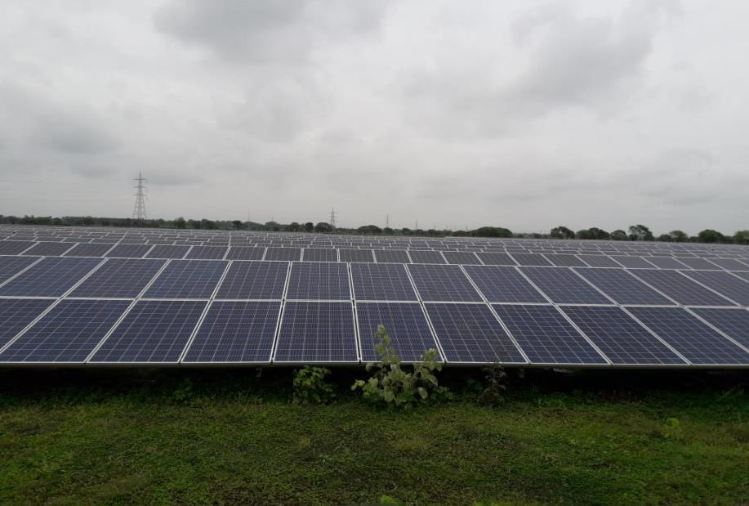
ESG Initiatives

Slide 27


Water Positivity Index
Target of becoming 5 times water positive by FY25
4X
FY20
FY21
FY22
FY23
FY25

Slide 28
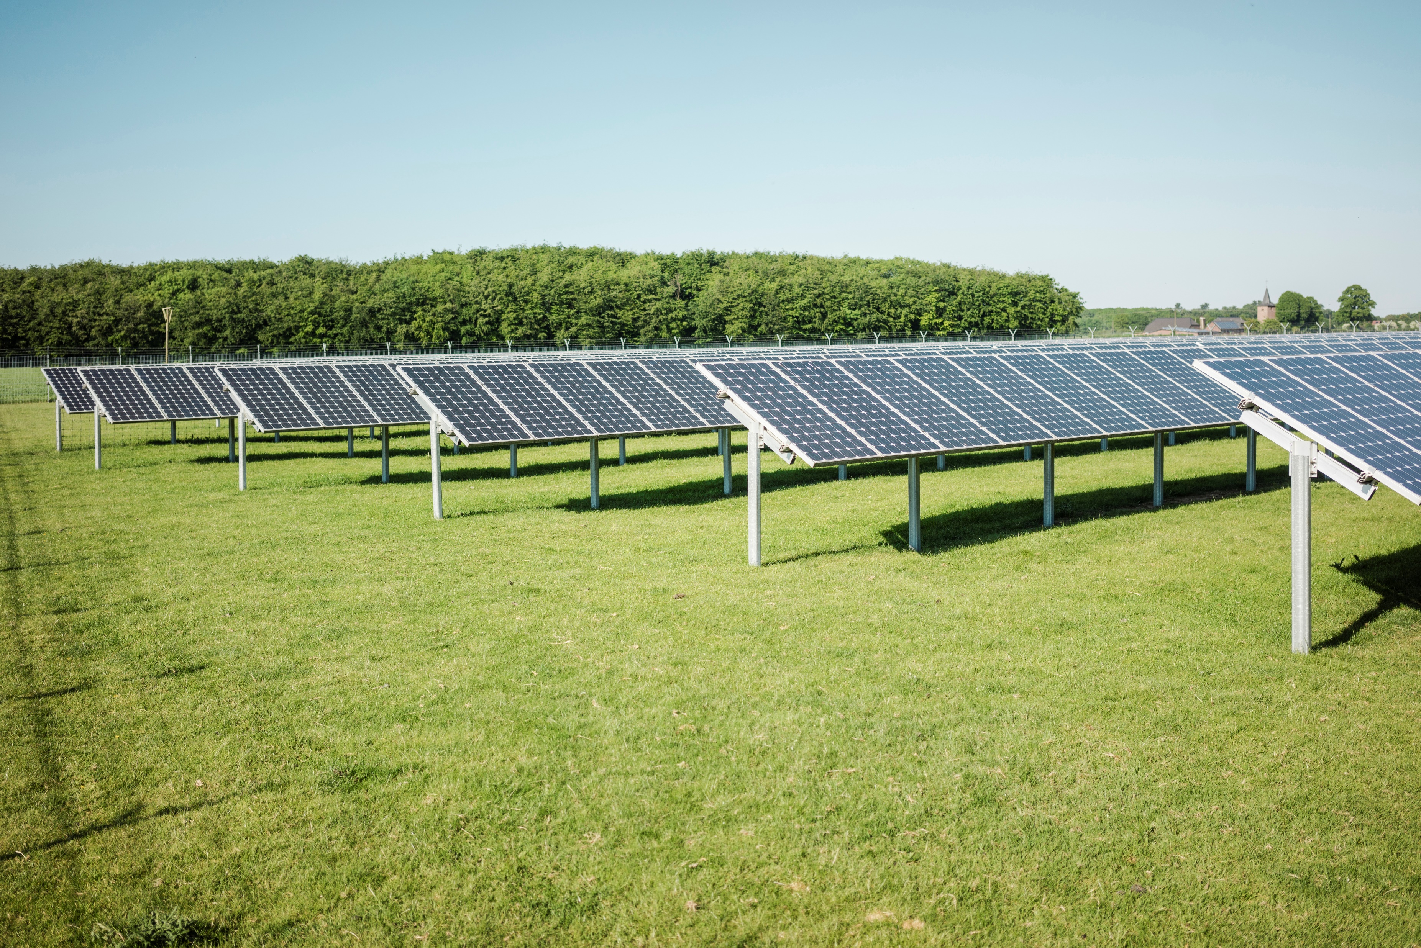
Green Power
Share of Renewable Energy in Total Installed Captive Power Capacity (MW) at
JK Lakshmi Cement and UCWL
JKLC – Captive Power (205 MW)
UCWL – Captive Power (28 MW)
Share of Green Energy in Total Power Requirement (%) *
* For Six Months period Apr’24-Sept’24

Slide 29
Increasing Thermal Substitution Rate
In FY24, JKLC has achieved a TSR% of 7%
To enhance the TSR%, we have ordered pre & co processing facilities
TSR% to be increased to 20% at JKLC FY 30

Slide 30
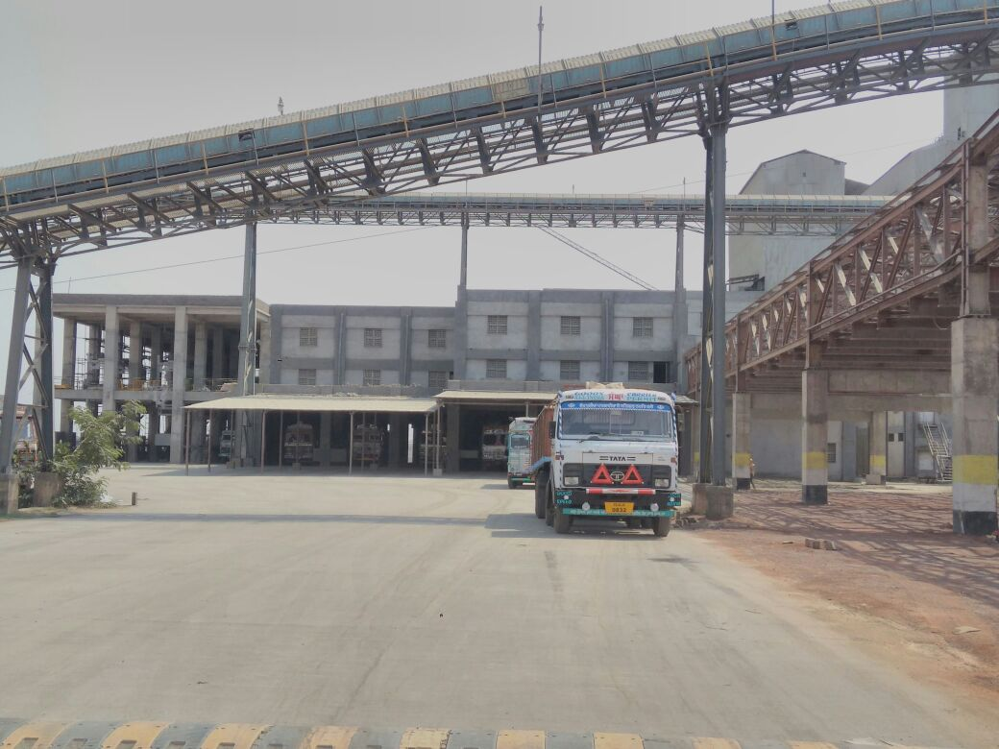
J K Lakshmi Cement:
Operational & Financial Performance Q2FY25

Slide 31
Volume Growth (Sales) - Quarterly
Lakh Tons
JKLC
UCWL
Consolidated

Slide 32
Volume Growth (Sales) – (Six Months ended 30.09.2024)
Lakh Tons
JKLC
UCWL
Consolidated

Slide 33
Capacity Utilisation

Slide 34
Region-wise Cement Sales – North/West (JKLC)

Slide 35
Region-wise Cement Sales – East (JKLC)

Slide 36
Revenue Growth - Quarterly
₹ in Crore
JKLC
UCWL
Consolidated
* SBS ~ Smart Building Solution

Slide 37
Revenue Growth – (Six Months ended 30.09.2024)
₹ in Crore
JKLC
UCWL
Consolidated
* SBS ~ Smart Building Solution

Slide 38
Cost Trend
Fuel Cost and Lead Distance - JKLC
Fuel Cost ₹ / K.Cal.
Lead Distance (Kms.)

Slide 39
Renewable Energy - Quarterly
JKLC
UCWL
Consolidated

Slide 40
Renewable Energy – (Six Months ended 30.09.2024)
JKLC
UCWL
Consolidated

Slide 41
Product Mix
Blended Cement - Quarterly
JKLC
UCWL
Consolidated

Slide 42
Product Mix
Blended Cement – (Six Months ended 30.09.2024)
JKLC
UCWL
Consolidated

Slide 43
Profitability - Quarterly
JKLC
UCWL
Consolidated
EBIDTA* - ₹ in Crore
EBIDTA* - ₹ / Ton
* EBIDTA ~ excluding Other Income

Slide 44
Profitability – (Six Months ended 30.09.2024)
JKLC
UCWL
Consolidated
EBIDTA* - ₹ in Crore
EBIDTA* - ₹ / Ton
* EBIDTA ~ excluding Other Income

Slide 45
JKLC (Standalone) Financial Statement - Quarterly
₹ in Crore

Slide 46
UCWL (Standalone) Financial Statement - Quarterly
₹ in Crore

Slide 47
Consolidated Financial Statement - Quarterly
₹ in Crore

Slide 48
JKLC (Standalone) Financial Statement – (Six Months ended 30.09.2024)
₹ in Crore

Slide 49
UCWL (Standalone) Financial Statement – (Six Months ended 30.09.2024)
₹ in Crore

Slide 50
Consolidated Financial Statement – (Six Months ended 30.09.2024)
₹ in Crore

Slide 51
JKLC (Standalone) Financial Statement – (Twelve Months ended 31.03.2024)
₹ in Crore

Slide 52
UCWL (Standalone) Financial Statement – (Twelve Months ended 31.03.2024)
₹ in Crore

Slide 53
Consolidated Financial Statement – (Twelve Months ended 31.03.2024)
₹ in Crore

Slide 54
JKLC Standalone Balance Sheet
₹ in Crore

Slide 55
JKLC Consolidated Balance Sheet
₹ in Crore

Slide 56
Debt Profile
Standalone
Gross Debt
Cash
Net Debt
₹ in Crore
₹ in Crore
₹ in Crore
Consolidated
Gross Debt
Cash
Net Debt
₹ in Crore
₹ in Crore
₹ in Crore

Slide 57
Standalone Debt Profile
Standalone
Net Debt/EBIDTA
Net Debt/Equity
Consolidated
Net Debt/EBIDTA
Net Debt/Equity

Slide 58
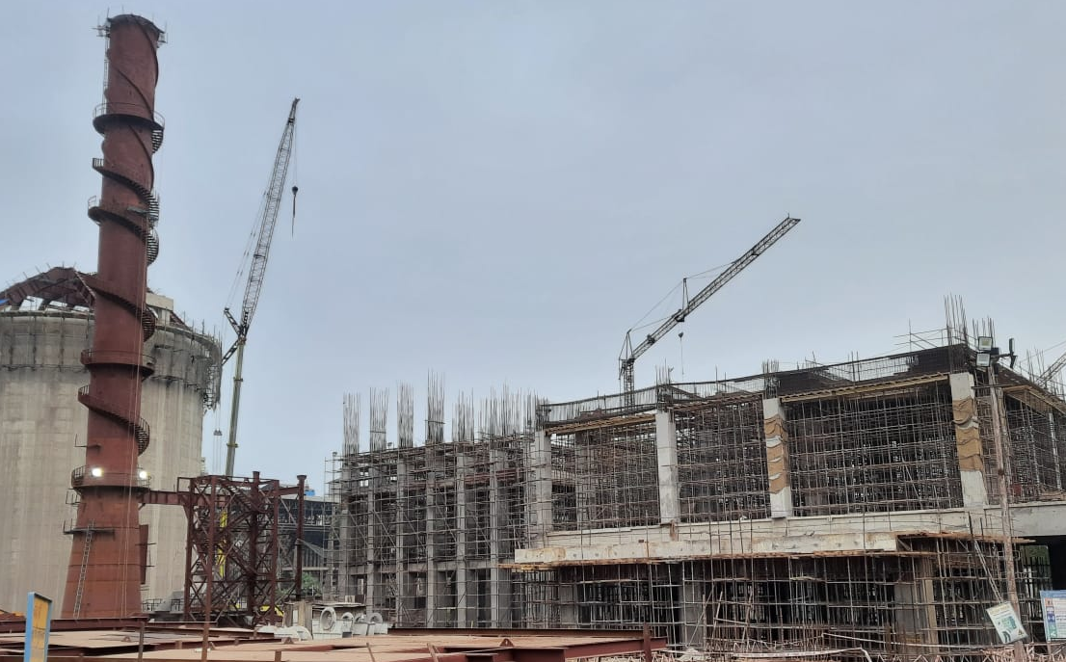
Ongoing CAPEX
₹ in Crore
2.50 Mn. Ton
Expansion Project
at
UCWL

Slide 59
Ongoing CAPEX
₹ in Crore
Railway Siding at Durg

Slide 60
Ongoing CAPEX
₹ in Crore
Surat Grinding Unit - Expansion

Slide 61
Ongoing CAPEX
₹ in Crore
Durg - Expansion

Slide 62
JKLC
Shareholding Pattern
As on
30.09.2024

Slide 63
UCWL
Shareholding Pattern
As on
30.09.2024

Slide 64
    Consistent Dividend Payout Ratio
    18% for FY 2024.
    13% for FY 2023.
    14% for FY 2022.
    12% for FY 2021.
          15% for FY 2020.
    13% for FY 2019.
          13% for FY 2018.
          13% for FY 2017.
    56% for FY 2016.
          30% for FY 2015.
    20% Average for last 10 Years
JKLC
Shareholder’s Friendly Initiatives

Slide 65
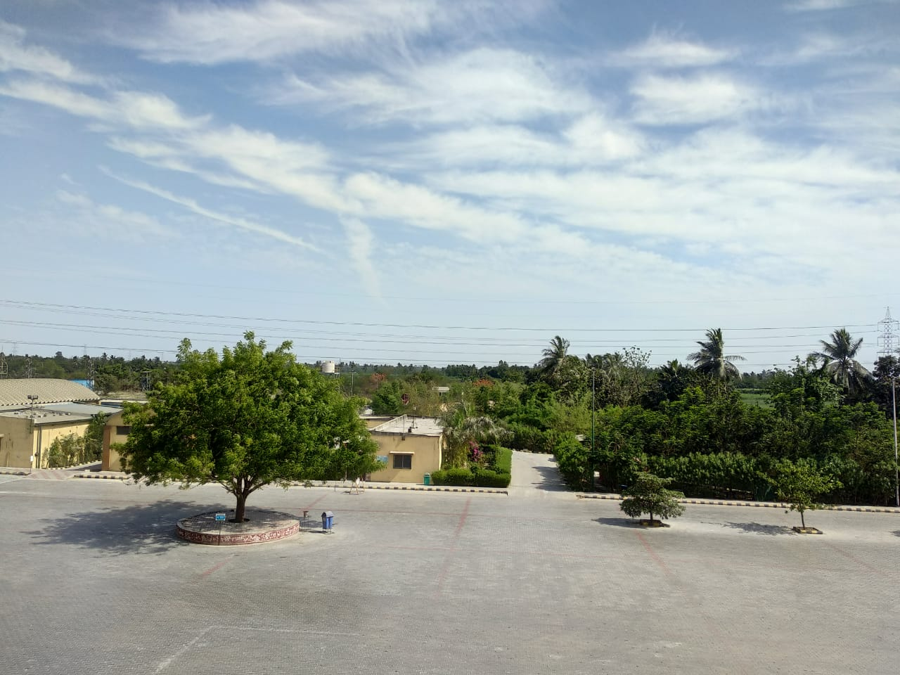
Corporate Social Responsibility

Slide 66
Our CSR Footprints & Population Coverage –
Directly Impacting more than 2.25 L people
Rajasthan
  Pindwara, Sirohi
  35 Villages & 53 hamlets
  80,000 Population
Haryana
  Jharli, Jhajjar
  23 Villages
  32000 Population
Surat
  5 Villages
  12000 Population
Chhattisgarh
  Durg
  7 Villages
  24000 Population
Gujarat
  Kalol, Gandhinagar
  18 Villages
  60000 Population
Orissa
  Cuttack
  4 Villages
  8000 Population

Slide 67




Our CSR Vision
To strengthen community relationship and to bring sustainable change in quality of life of neighborhood community through innovative solutions in Health, Education, Livelihoods and Rural Development.
Health, Water & Sanitation
Education
Livelihood & Skill Development
Rural Development
Notes:
Table to be recd

Slide 68
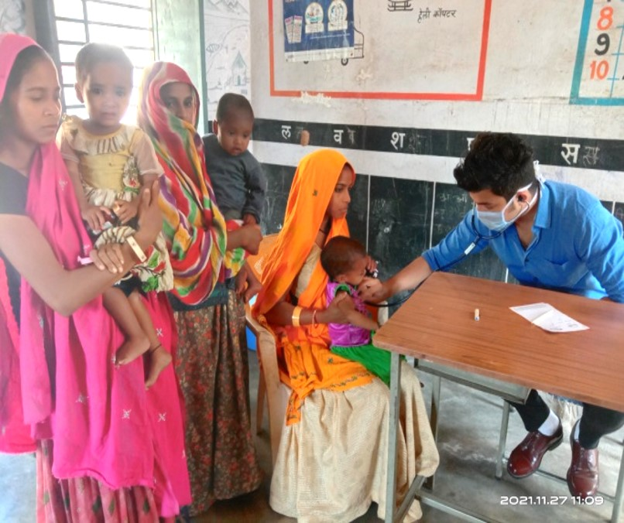
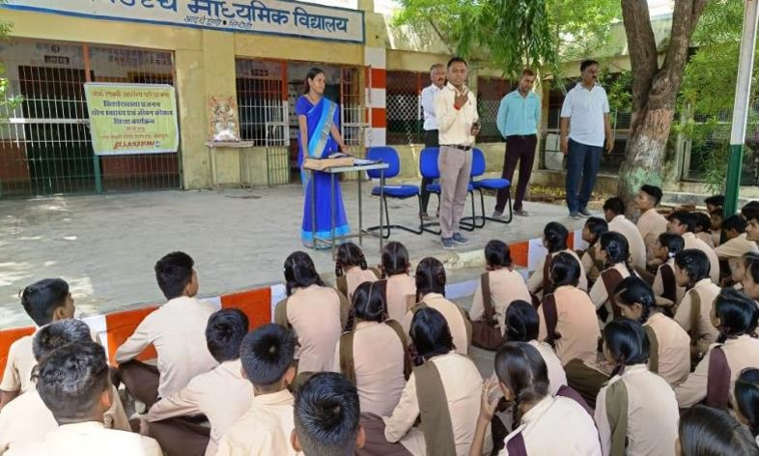
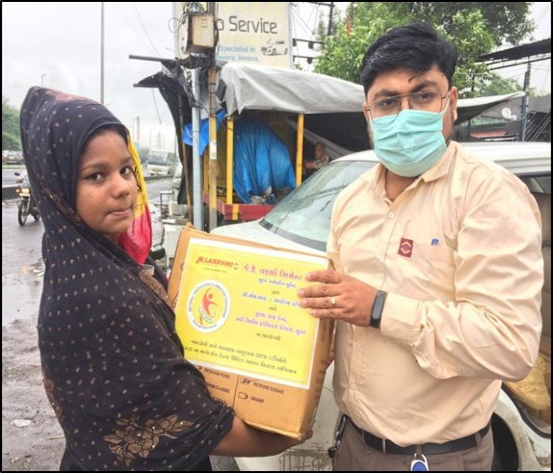
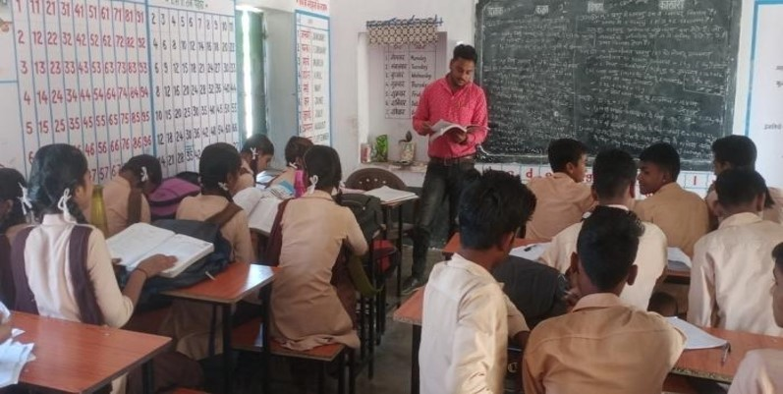
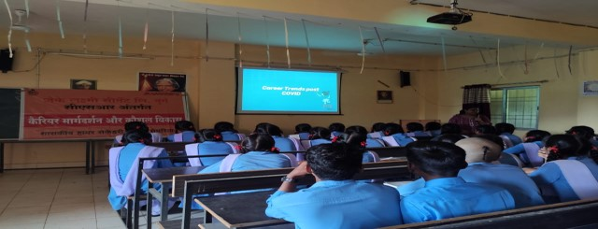
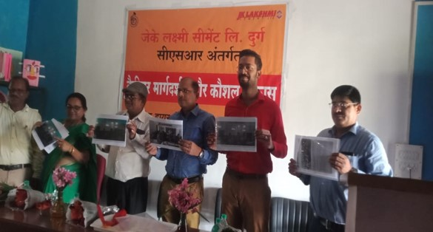
Health & Education Projects
Notes:
Table to be recd

Slide 69
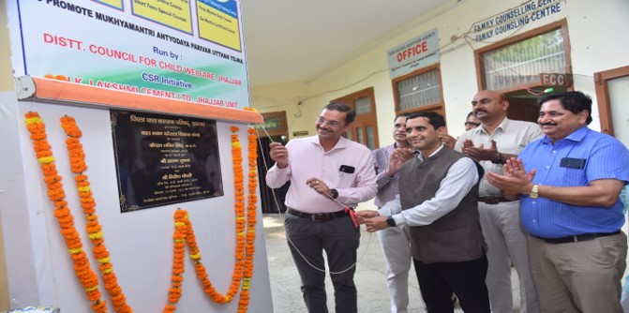
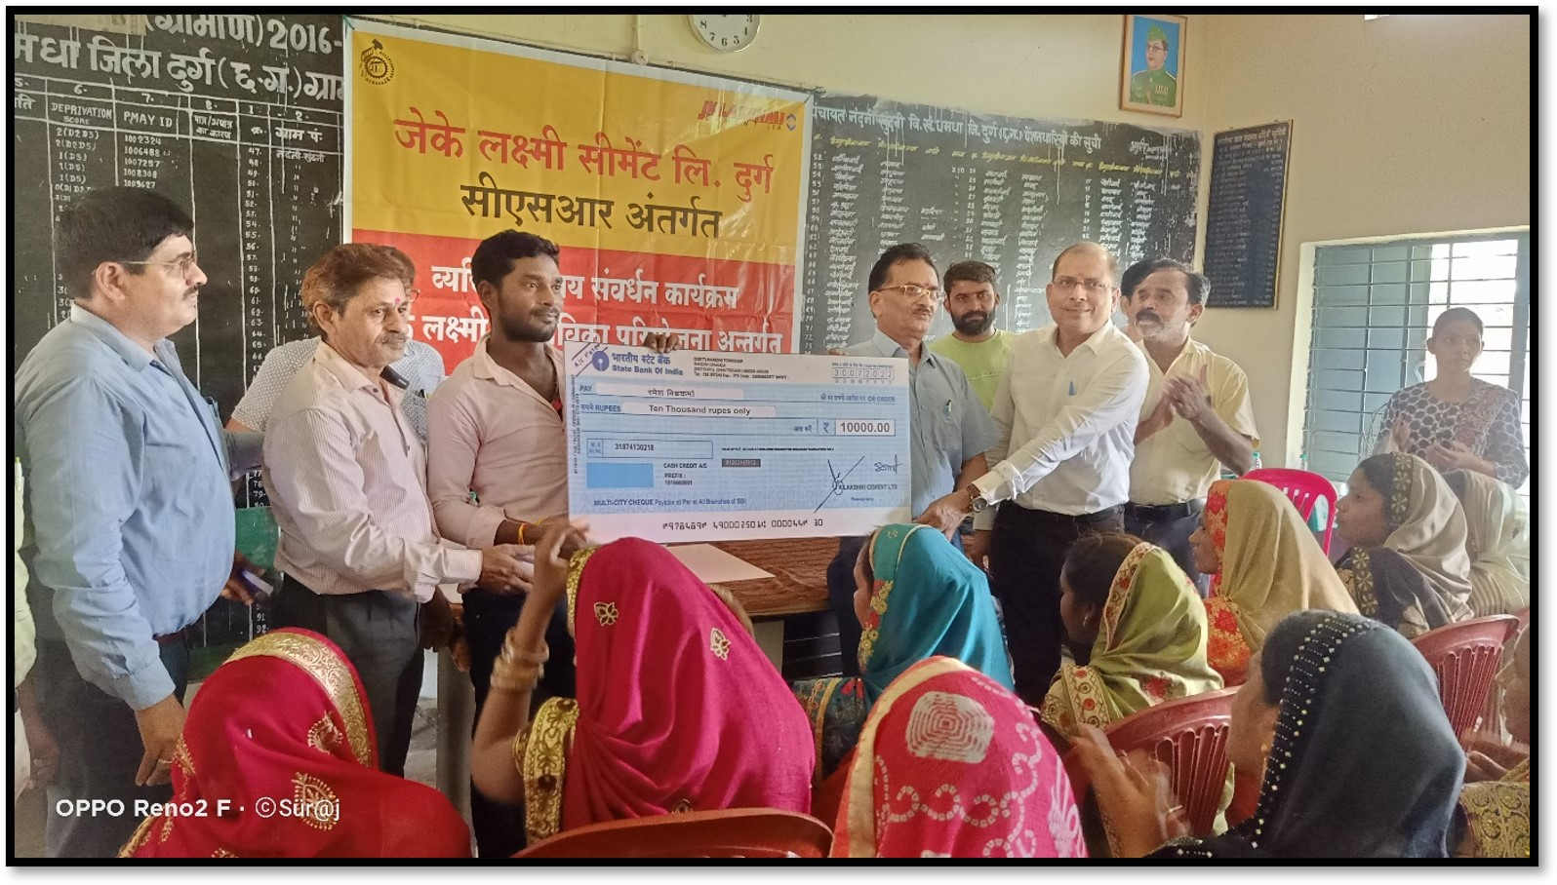
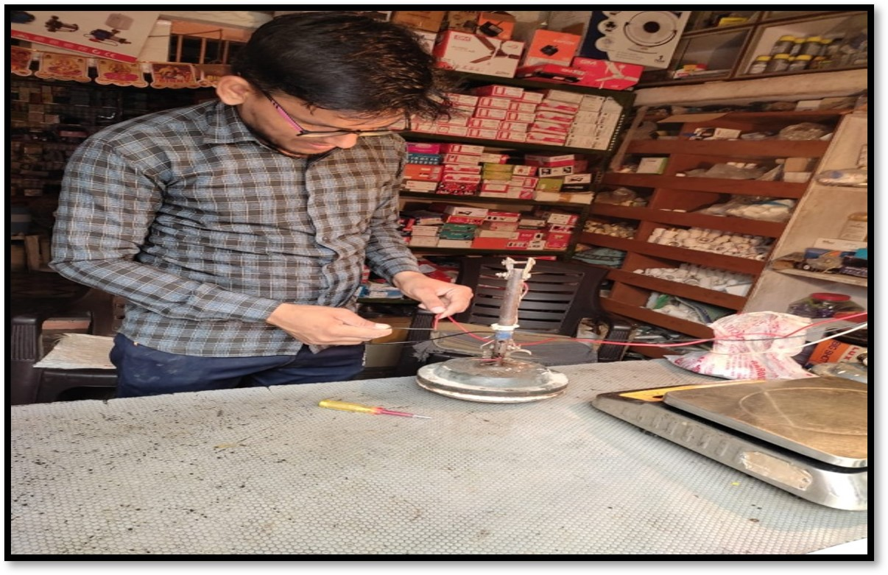
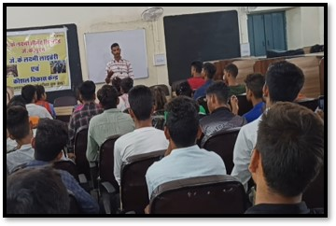

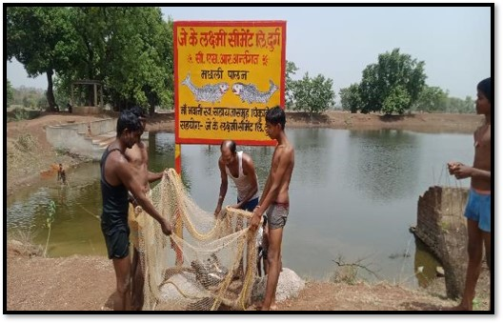
Promoting Multiple Livelihoods
Notes:
Table to be recd

Slide 70
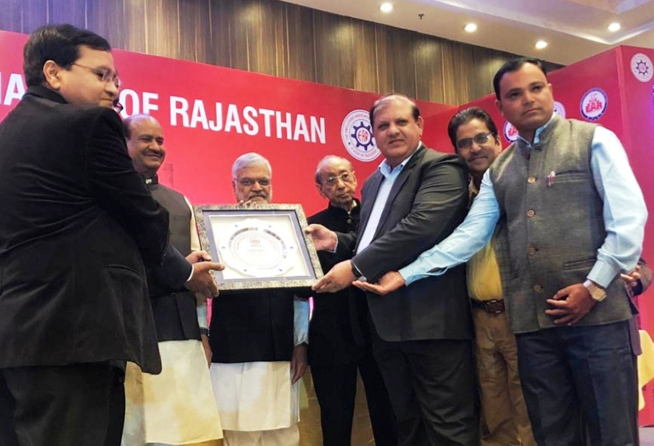
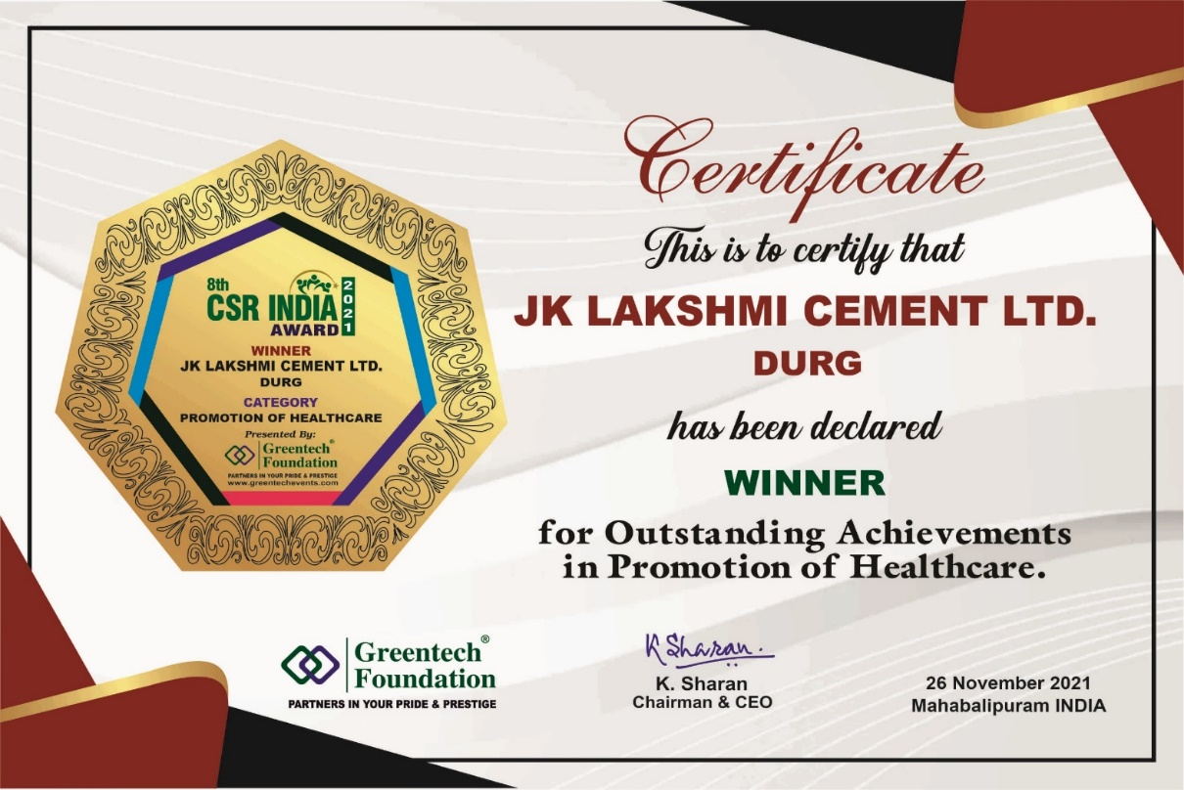
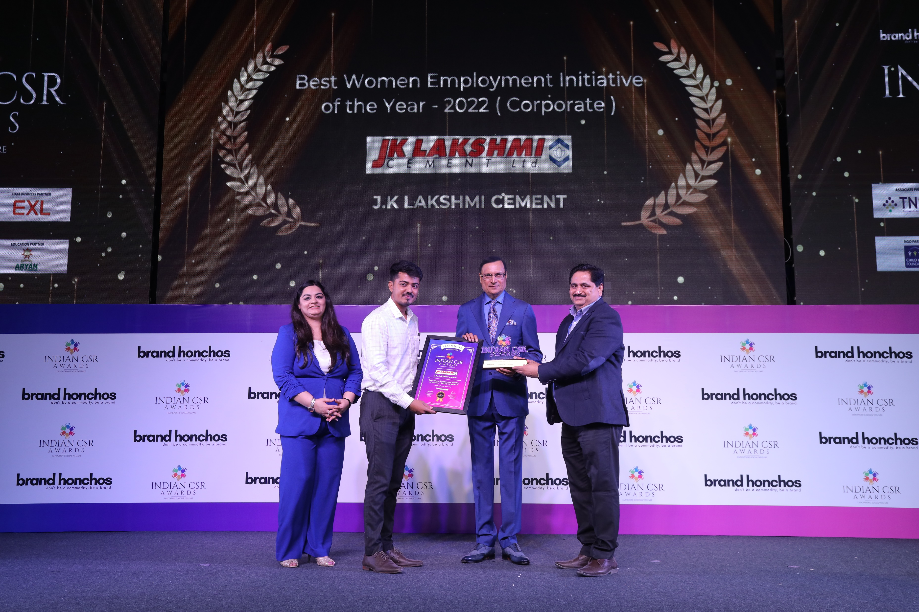
JKLC CSR has been recognized through multiple awards
Sirohi unit received “Outstanding Performance in CSR Excellence Trophy-2021” by The Employers Association of Rajasthan
Durg unit received “8th Greentech CSR Award 2021 for Outstanding Achievement in Promotion of Health Care” by Greentech Foundation, New Delhi
Jhajjar unit received ““Indian CSR Award for Best Women Employment Initiative of the Year (Corporate), 2022.”” by Greentech Foundation, New Delhi
Notes:
Table to be recd

Slide 71
Way Forward - JKLC
  The Board of Directors of the Company, at their Meeting held on 31st July 2024, have approved a Composite Scheme of Amalgamation and Arrangement (The Scheme) for amalgamation of the 3 Subsidiary Companies, viz Udaipur Cement Works Ltd, Hansdeep Industries & Trading Company Ltd & Hidrive Developers and Industries Private Ltd into & with the Company w.e.f. the Appointed Date of 1st April 2024 subject to the requisite Statutory & Regulatory Approvals, as applicable.
  Project for Capacity Expansion of 2.50 Mn. Ton at UCWL was commissioned in March’2024.
  The Company has taken-up for implementation setting up of additional Cement Grinding Unit of 1.35 Million Tonnes Per Annum at its existing Surat Grinding Unit.

Slide 72
Way Forward - JKLC
  The Company has tied-up under the Captive Route, sourcing of Solar Power of 40 MW for its Integrated Cement Plant at Durg in Chhattisgarh. With this Sourcing, the Share of Renewable Power at Durg Cement Plant has increased from 36% to 80% from October 2023.
  The Company is expanding the Clinker Capacity at its integrated Cement Plant at Durg in Chhattisgarh by putting up an Additional Clinker Line of 2.3 Million Tonnes Per Annum & Four Cement Grinding Units aggregating to 4.6 Million Tonnes Per Annum at Durg in Chhattisgarh and also Three Split Location Cement Grinding Units with aggregate Cement Grinding Capacity of 3.4 Million Tonnes Per Annum at Prayagraj in Uttar Pradesh, Madhubani in Bihar & Patratu in Jharkhand.
  The Company is foraying in North Eastern Market of India for setting up a Clinkerisation Unit of 1 Mn.MT and Cement Grinding Unit of 1.5 Mn. MT through Greenfield Expansion in the State of Assam.
  The Company has deep penetration in rural markets.

Slide 73
Way Forward - JKLC
  Short Term rating continues at A1+ (highest possible rating) (CRISIL & CARE).
  Long Term rating is ‘AA’ by CRISIL and CARE.
  Efficiency Parameters amongst best in Industry.
  One of the Least Cost Producer of Cement in Industry.
  Key Financial Ratios well within accepted Norms.
  Has Become a PAN India Player (Barring South) with a Capacity of 17 Mn.
  Plans ready to cross 30 Mn. MT by FY’30.

Slide 74
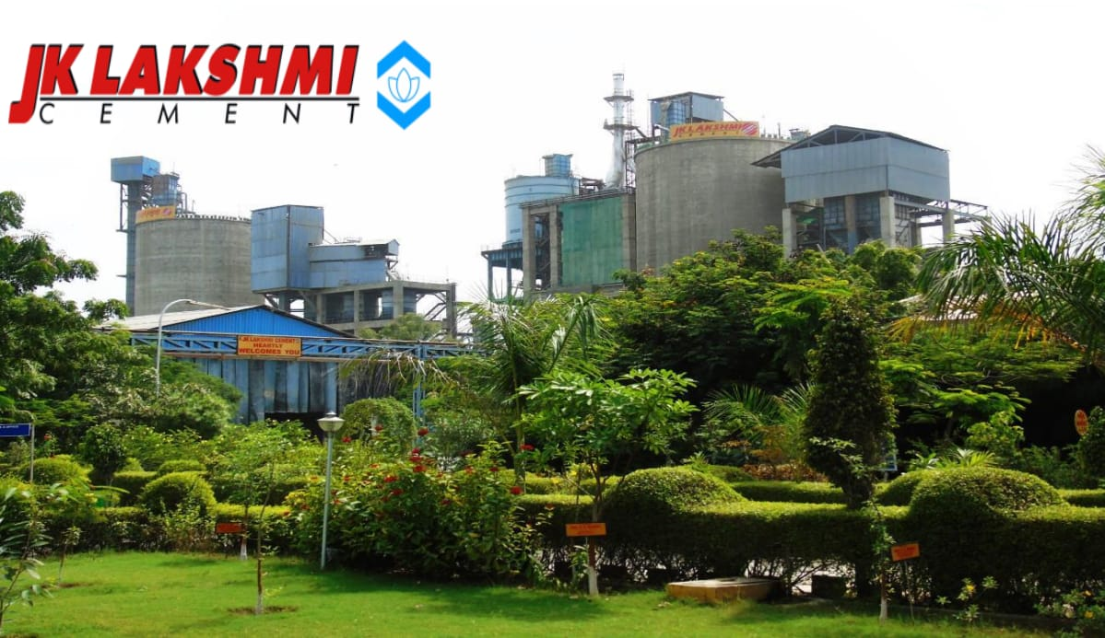
Thank you
Registered Office : Jaykaypuram, Distt. : Sirohi – 307019, Rajasthan
Website : www.jklakshmicement.com
E-mail id : Lakshmi_cement@lc.jkmail.com

